Slide 1


Rollout of Idea Collection Platform
Innovation Stream, India, 09-04-2020

Slide 2


Guidelines
An idea can be related to improving an existing system/process (incremental) or creating a new system to attract add-on revenue
An idea should clearly state the potential benefit or the business use case associated with it
If more than one people contributes to an idea / POC then it is recommended to limit the team size to 3 members and one member can act as team lead
All logged ideas are important and will be screened on following key parameters
Strategic fitness
Business/Market potential
Technical feasibility
Cost benefit
Based on the evaluation parameters mentioned above, the innovation review board will approve an idea and then will pick few ideas which are strategically aligned with the organization’s future plan
Selected idea owners would be invited to present their ideas in-front of the review board
Owners of every approved Idea will be presented with a certificate of appreciation and top 3 selected idea owners will be presented with exciting awards and their ideas will be showcased at relevant local and global platforms
Based on their market potential, the organization would provide the required resources for the implementation and release of an idea

Slide 3
Ideas identified by team
Automation of production deployments with CI/CD : DSG DFM - Krishnamurthy
Generate automation test report using Karate DSL (BDD) framework : DSG CHARGE - Devesh
Generate weekly health report for external API’s call (i.e.- SAMSON/CHUB etc.) : DSG CHARGE - Devesh
Customer Segment - Data Science Logic : DSG DFM - Ajay
Common Logging Framework : DSG DFM - Ajay
Integrated CustomerInfo 360 : DSG CHUB - Dharini Rajendran
Faster Triaging of failures Using Splunk : DSG CHUB - Nitin Yadav
Faster Triaging of failures Using Splunk : DSG CHUB - Siddhartha Das
Know error database/ Knowledge database : DSG - Krishnamurthy & Devesh

Slide 4
Automation of production deployments with CI/CD
OrderManagement Team

Slide 5

My Idea is… Automating Production Deployments
Title: | Automating Production Deployments
Idea Type: | Incremental / Disruptive Innovation
Idea Description: | Automating the production deployment end to end. Currently we are doing it on the approval basis where it involves the different level of approval from management. We can have the new features as and when they are developed, now these things are getting delayed because of the monthly deployments.
Benefits: (in terms of money, effort or user experience) | Manual intervention can be removed. New features will be available to customer immediately. Approval process will be removed.
Applicable To: (project, vertical, global) | Project
Owned By: | DSG – OrderManagement Team ( Krishnamurthy G)
Note: Add slides to this presentation to provide details about the idea. Having a proof of concept/working model to demonstrate would be an added advantage.

Slide 6
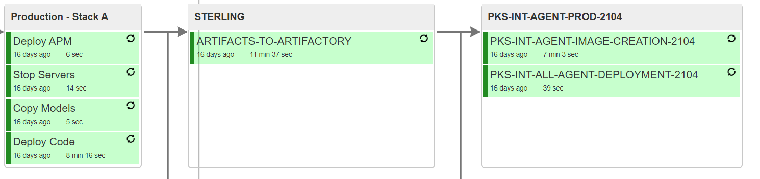
Current Scenario
Overview of Automating Production Deployments
Automating the production deployment with CI/CD pipeline. We are planning to use GITLAB for the CI/CD pipeline implementation.
Currently we don’t have the CI/CD pipeline for the production deployments. We have set of Jenkins jobs to perform production deployments.
We need to spend almost 20-30 mins for artifacts generation for every production release.
Currently we don’t have the CI/CD pipeline for the production deployments. We have set of Jenkins jobs to perform production deployments.
We need to spend almost 20-30 mins for artifacts generation for every production release.
Post deployment we need to spend almost 1 hour for the verification which can be automate.
Here is the current production deployment view:
Notes:
Bill

Slide 7
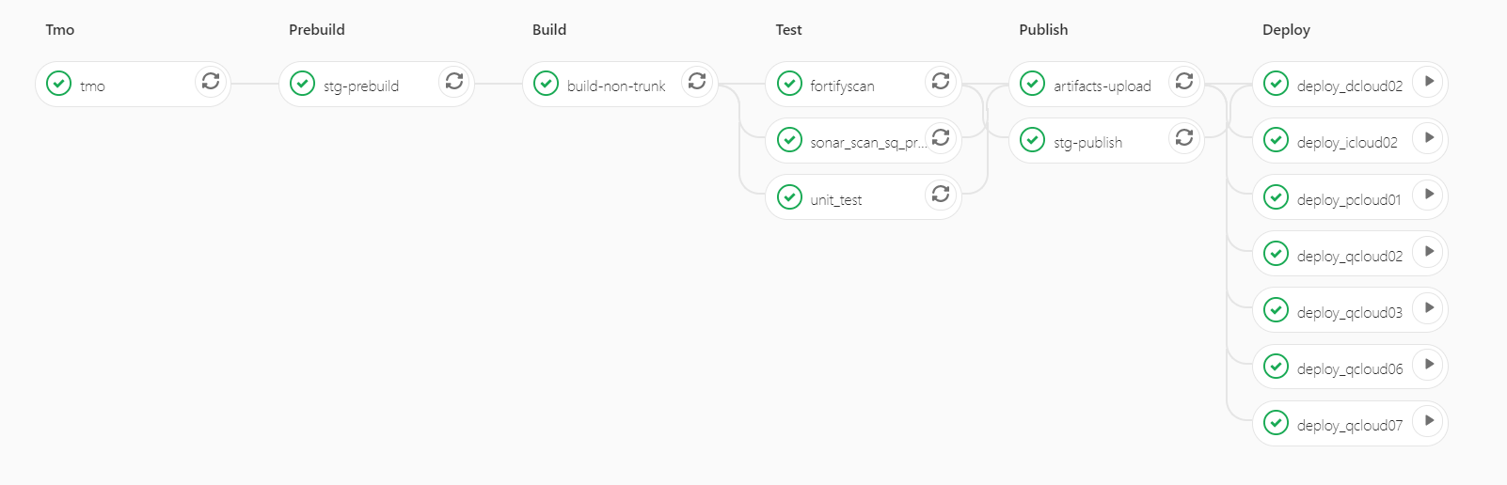
CI/CD Flow For Production Deployment
Proposed Scenario
CI/CD pipeline
This will remove the artifacts generation time 20-30 mins every release.
This will remove the post deployment validations time of 1-2 hours every release.
Pipeline as a code with version management.
Integration of the PIER ticket approval with the CI/CD Pipeline.
This will follow the approval process with the PIER ticket integration.

Slide 8

Q & A

Slide 9
Generate automation test report using Karate DSL (BDD) framework
DSG Team

Slide 10
My Idea is…
Title: | Generate automation test report using Karate DSL (BDD) framework
Idea Type: | Incremental Innovation
Idea Description: | Use Karate framework for the automation & generate test report accordingly. It will generate detailed test report, which will display all result in detailed way about Passed/Failed scenario with time execution.
Benefits: (in terms of money, effort or user experience) | Test report will be more informative, interactive & easy to understand for everyone(Technical or Non technical both) It will reduce Dev/QA's effort & time both(depending on issues), because as this report contains detailed information about Passed/Failed test cases for each Apps. So they can easily found the cause for failure, If the service is not responding correctly and so they can reached to respective team for the data related issue. Easy to write & understand test cases, because it will not create any dependency on language expertise(Java/Tibco etc). As this is the BDD framework, so it uses Gherkin keywork(i.e.- Feature, Scenario, Given, When, Then etc) & test case will be written in .feature files. Easy to integrate on Jenkin CI/CD pipelines.
Applicable To: (project, vertical, global) | All Project
Owned By: | DSG-Charge-Devesh
Note: Add slides to this presentation to provide details about the idea. Having a proof of concept/working model to demonstrate would be an added advantage.

Slide 11
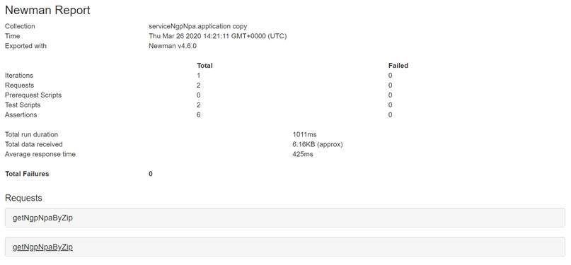
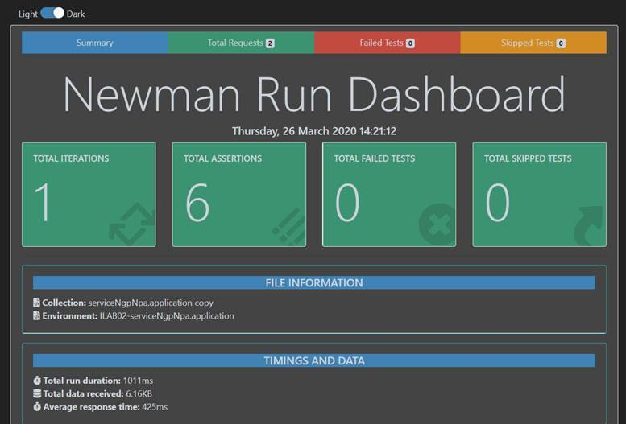
Current Scenarios
Overview of Karate DSL (BDD)
This framework is used for generate automation test report for the all existing App.
The report will be more interactive & easy to understand for anyone(Technical or Non- technical both).
. Automation test report is being generated through Newman Script currently.
Notes:
Bill

Slide 12
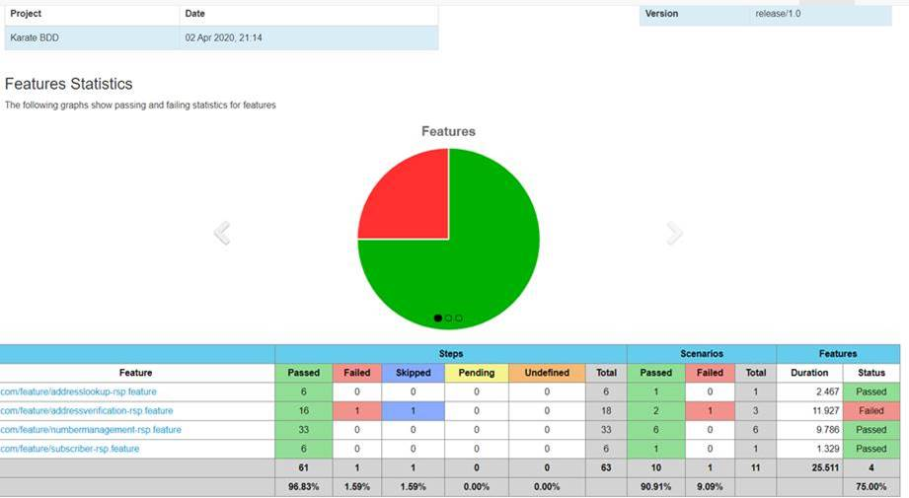
Proposed Scenarios
Karate DSL framework to generate the automation test report
Notes:
Bill

Slide 13
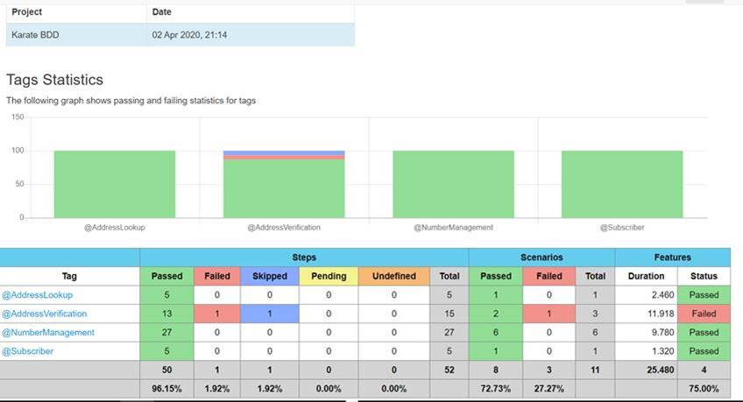
Proposed Scenarios
Notes:
Bill

Slide 14
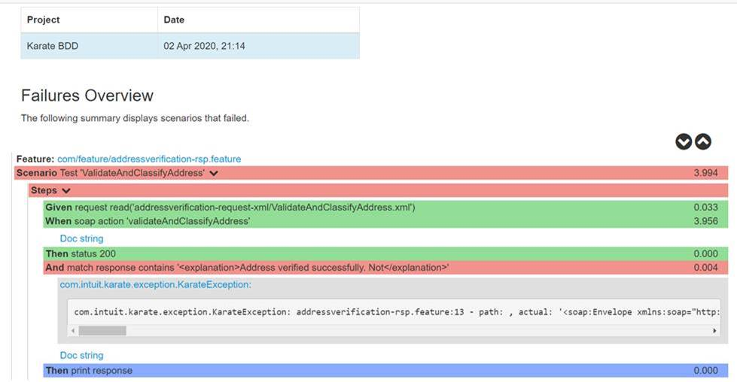
Proposed Scenarios
Notes:
Bill

Slide 15
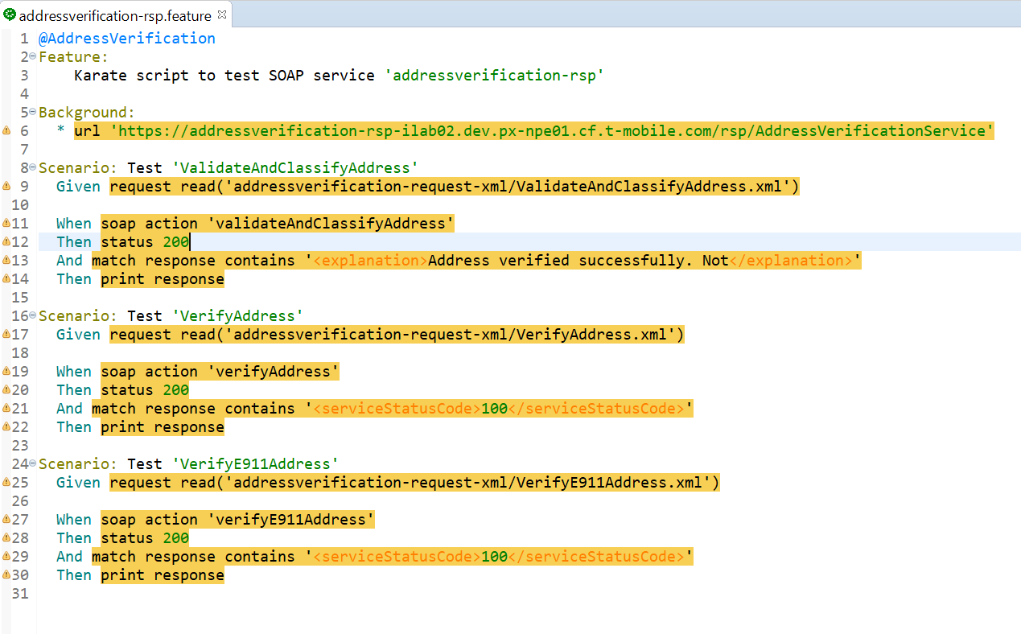
Test Case
Notes:
Bill

Slide 16
Q & A

Slide 17
Generate weekly health report for external API’s call (i.e.- SAMSON/CHUB etc.)
DSG Team

Slide 18
My Idea is…
Title: | Generate weekly health report for external API’s call (i.e.- SAMSON/CHUB etc.)
Idea Type: | Disruptive Innovation
Idea Description: | Develop application, which will generate weekly health report for all external API’s call (CHUB/SAMSON etc), which currently being used in our services to get the corresponding data(i.e.-In Charge/DFM).
Benefits: (in terms of money, effort or user experience) | Through this report, we can do the performance analysis of all external API's (Tuxedo/Chub etc.) while doing load testing, and then predict the data related issue which could come later due to service down or poor performance. And even we can suggest API’s vendor also for their hardware level upgradation, If required. QA/DEV's effort & time both would be save, because mostly the issue come on data level which is dependent external API call. But QA team directly jump to developer, and after dev analysis it come at data level which is coming through Tuxedo/Chub service call. So this report can help us to track the external service performance & save resource time accordingly. Easy to integrate on Jenkin CI/CD pipelines to automate it.
Applicable To: (project, vertical, global) | All project
Owned By: | DSG- Charge- Devesh
Note: Add slides to this presentation to provide details about the idea. Having a proof of concept/working model to demonstrate would be an added advantage.

Slide 19
Overview of health check report for external API’s call
It will generate weekly health check report for all external API’s call (CHUB/SAMSON etc) using Gatling framework, because these APIs are being used currently in our services to get the data(i.e.- Charge/DFM) and mostly the issue come at these data level.
We can do the performance analysis of external API's (Tuxedo/Chub etc.) through reports through load testing.
Current Scenarios
Currently we are not using any of the tool to generate external API’s health check reports.
Notes:
Bill

Slide 20
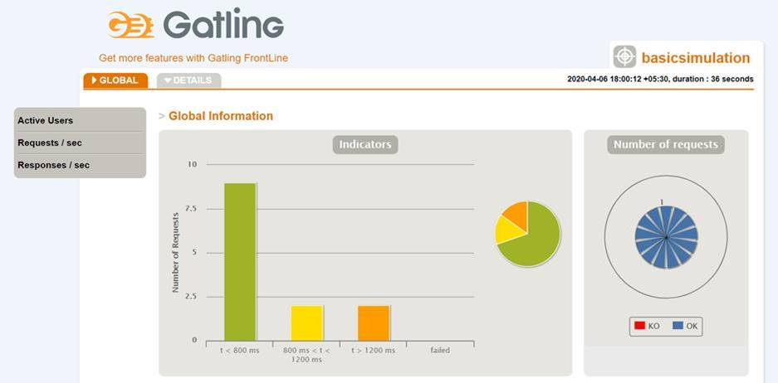
Proposed Scenario
Develop the application, which will generate weekly health report using Gatling (load & performance testing framework).
Notes:
Bill

Slide 21
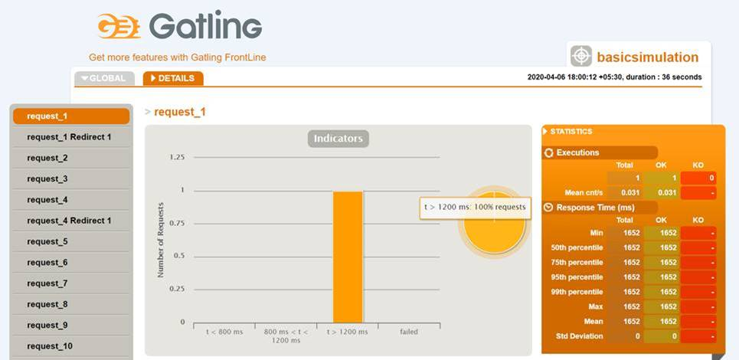
Proposed Scenario
Notes:
Bill

Slide 22
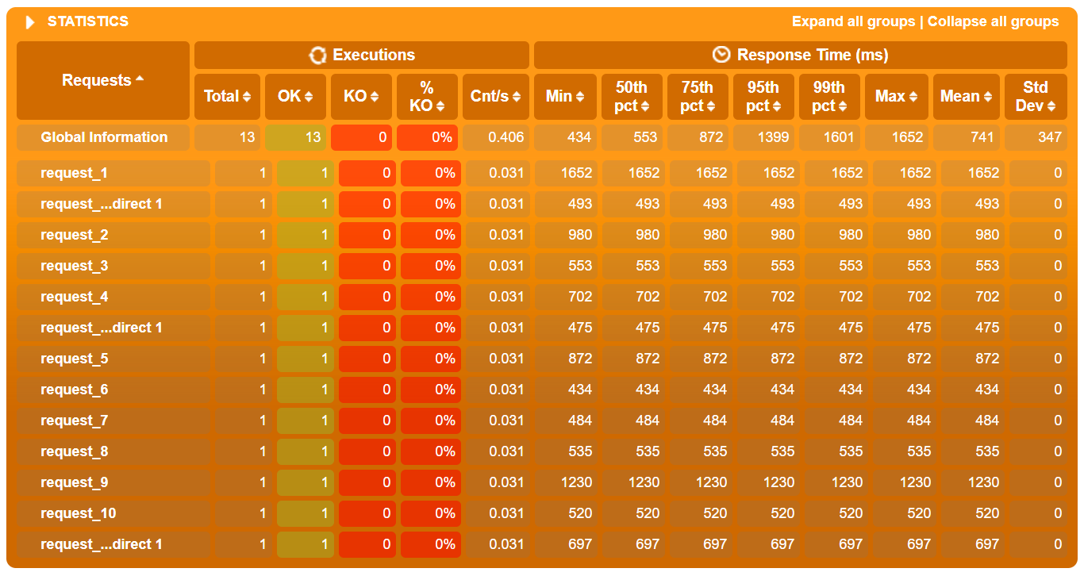
Proposed Scenario
Notes:
Bill

Slide 23
Q & A

Slide 24
Customer Segment - Data Science Logic
DSG Team

Slide 25
My Idea is…
Title: | Customer Segment - Data Science Logic
Idea Type: | Incremental Innovation
Idea Description: | The telecommunication companies is to segment their market and target the content according to each group. There are segmentation schemes of primary importance: customer value customer behavior customer lifecycle It will help to prediction, preferences and customer’s reaction to the services and offers.
Benefits: (in terms of money, effort or user experience) | The program will share offer based upon customer type. Not need to create any promotion for targeted customer. For Example: If customer paid bill > $ 1000 (Give Netflix offer) If customer data uses> 5GB/month (Give 1 GB extra data)
Applicable To: (project, vertical, global) | Project
Owned By: | DSG-DFM - Ajay
Note: Add slides to this presentation to provide details about the idea. Having a proof of concept/working model to demonstrate would be an added advantage.

Slide 26
Common Logging Framework
DSG Team

Slide 27
My Idea is…
Title: | Common Logging Framework
Idea Type: | Incremental Innovation
Idea Description: | The common logger framework will support to generate identical logs for all spring boot/tibco apps. It will be exposed as a build component for spring boot/tibco apps.
Benefits: (in terms of money, effort or user experience) | Support’s any cloud platform Generate identical logs Support’s any data masking Enhance Current Logging Remove boilerplate code Lesser issue triage time Easy to create the Splunk alert and dashboard
Applicable To: (project, vertical, global) | Global
Owned By: | DSG-DFM - Ajay
Note: Add slides to this presentation to provide details about the idea. Having a proof of concept/working model to demonstrate would be an added advantage.

Slide 28
Q & A

Slide 29
Integrated CustomerInfo 360
CHUB Team

Slide 30
My Idea is… Integrated CustomerInfo 360
>
Title: | Integrated CustomerInfo 360
Idea Type: | Technical
Idea Description: | Current Scenario: CustomerInfo 360 is the application that maintains CustomerInfo API catalog, deployments & release environments giving 360 degree view of our apps. This application is currently not integrated with any backend systems. In order to keep the data updated with latest developments & deployments it requires manual update after every Sprint. This new process will be mandated soon for all sprint teams & team members. Proposal: Any process that involves manual update will not guarantee that information is 100% accurate & up-to-date. It is critical & important that we keep the application latest when its being shared with our partners/consumers/leadership team. One way to solve this is by automating this process so the app is refreshed after every check-in. The new flow will be Developers check in & Deploy the app-> Inject our new automation script/process in Jenkins pipeline-> Automated script will pick appname, deployment info etc & update DB tables -> CustomerInfo 360 app will then be integrated to pull latest information from these DB tables.
Benefits: (in terms of money, effort or user experience) | Manual update per sprint for all resources: 2 hours Manual update after every deployment (QA & PROD) for all resources: 2 hours Total manual hours that would be spent in a year = No. of Sprints * 2 + No. of deployments * 4 = 26*2 + 24 * 2 = 56 + 48 = 104 Hours. 104 Manual hours will be saved in a year by automating this solution.
Applicable To: (project, vertical, global) | Project
Owned By: | Customer Info Team (Dharini Rajendran)
Note: Add slides to this presentation to provide details about the idea. Having a proof of concept/working model to demonstrate would be an added advantage.

Slide 31
Agile Gamification
CHUB Team

Slide 32
My Idea is… Agile Gamification
Title: | Agile Gamification
Idea Type: | Innovation
Idea Description: | Currently there is no way to track team progress on Agile Concepts and the assessment is driven by participation of 3 Amigos – Product Owner, Dev Lead and Scrum Master. Team has challenges understanding some of the very basic concepts and we need to help them by understanding areas where training is needed.
Benefits: (in terms of money, effort or user experience) | Our aim is to get a snapshot of the state of the practice of gamification and agile software development, and to discover what evidence there is about the benefits of this integration. Helps improve team engagement and collaboration. Identify areas of improvement for training. Helps with Agile Transformation Journey. Low Investment. Big Impact. Break from routine work excites team members.
Applicable To: (project, vertical, global) | Global
Owned By: | Customer Info – Nitin Yadav

Slide 33
Faster Triaging of failures Using Splunk
CHUB Team

Slide 34
My Idea is… Reduce Analysis Time for Critical Incidents
Title: | Faster Triaging of failures Using Splunk
Idea Type: | Incremental / Disruptive Innovation
Idea Description: | For Customer Info. application log analysis is done using Splunk. But Siebel application and real time interface logs are not integrated to any Log aggregator system and it makes it cumbersome to analyze in case there is a high priority incident. Use Elastic Logstash and Kibana Oracle database connector for monitoring Siebel application interface KPIs. Logstash has an inbuilt connector using JDBC to connect to Oracle. Kibana is a great data visualization and exploration tool. Elasticsearch is a great datastore that is dead easy to work with, and Logstash makes getting data from a ridiculously large and varied number of sources an absolute doddle. It’s a stack frequently used for monitoring and diagnosing applications including Siebel and Oracle performance data. Provides a complete insight to how your application and hosted APIs are performing with simple clicks.
Benefits: (in terms of money, effort or user experience) | Convenient Cost-Effective initial setup . Elasticsearch, Logstash, and Kibana are all open-source tools unlike Splunk. Error Source available at single location. Can be used to take preventive approach for maintaining the applications stack as the team is well updated with alerts as to what errors are occurring at any given time frame. Easy to configure custom scenarios e.g. search indexes and visualizations for any scenarios that might be helpful or needed in the future. Search algorithms are much faster than any other product in the market Widely used across multiple organizations across the globe
Applicable To: (project, vertical, global) | Customer Info
Owned By: | Customer Info – Siddhartha Das

Slide 35
Known error database/ Knowledge database
OrderManagement Team

Slide 36
My Idea is… Know error database/ Knowledge database
Title: | Know error database/ Knowledge database
Idea Type: | Incremental / Disruptive Innovation
Idea Description: | The production support team will face many issues which re-occurs sometimes. We will create one Wikipedia for our project where we will store all our know issues. If we face any issue we can search the Wikipedia with some search options so that we will get the similar issues with the resolution.
Benefits: (in terms of money, effort or user experience) | Reduce the time to fix the issue in production. It will improve the resource utilization. Reduce the manual effort to fix the known issue.
Applicable To: (project, vertical, global) | Project
Owned By: | DSG – Order-Management Team
Note: Add slides to this presentation to provide details about the idea. Having a proof of concept/working model to demonstrate would be an added advantage.

Slide 37
Overview of known error database / Knowledge database
Known error database / Knowledge database can be used as the Wikipedia for the OMNI team.
Team member can directly go to knowledge database application and check the know errors if any issues occur in production/ non-production environments.
Current Scenario
The production support team will face many issues which re-occurs sometimes. Our idea is to create one Wikipedia for our project where we will store all the known issues.
For an Ops member this task takes around 15-20 min for each P2/P1 PIER tickets.
One resource should work on these tickets every day.
Human involvement is often prone to errors and delayed response.
Utilization of the member to the productivity goes DOWN
Proposed Scenario
We are planning to implement this as a Wikipedia where we can search for any issues/errors
This is the java-based application.
Utilization of the member to the productivity goes UP.
Zoho Wiki (an easy-to-use knowledge management tool for teams)
Notes:
Bill

Slide 38
Q & A

